Slide 1
CS6611 CREATIVE AND INNOVATIVE PROJECT
MADRAS INSTITUTE OF TECHNOLOGY
DEPARTMENT OF COMPUTER TECHNOLOGY
TITLE : CropForEst - A Machine learning based crop yield estimation and profitability analysis for precision agriculture.
SUNDARAJAN R B / 2020503549
HAMILTON SAMIC S / 2020503511
SURIYAA V / 2020503550
MENTOR : Dr. C. Valliyammai

Slide 2

DOMAIN
Machine Learning
Deep Learning

Slide 3
PROBLEM STATEMENT
The agriculture industry faces a significant challenge in predicting crop yield production and crop demand accurately. The traditional methods of predicting crop yield and demand are time-consuming and can be prone to errors, leading to inefficient use of resources and revenue loss. There is a need for predicting the most suitable crop based on various influential factors and forecasting the profitability.

Slide 4
OBJECTIVES
To develop an intelligent platform that uses machine learning algorithms to estimate the most suitable crop for cultivation in a given area based on environmental factors.
To forecast market demand and pricing trends for the identified crop, with the aim of increasing profitability for farmers and stakeholders in the agriculture industry.

Slide 5
MODULES
Data pre-processing
Model selection
Model integration
Model training
Application interface development

Slide 6
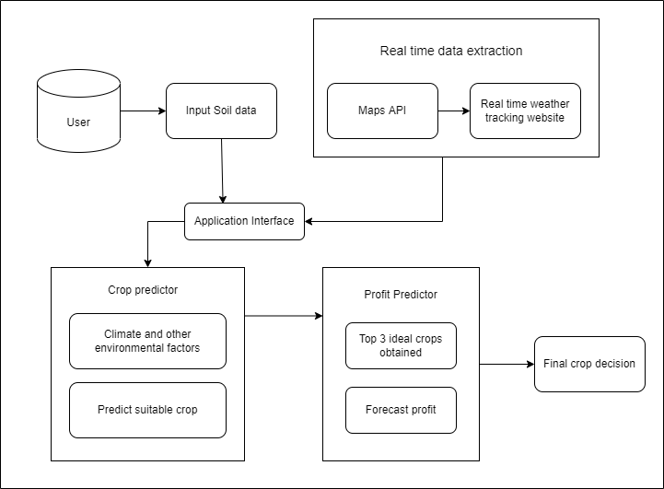
ARCHITECTURE DIAGRAM

Slide 7
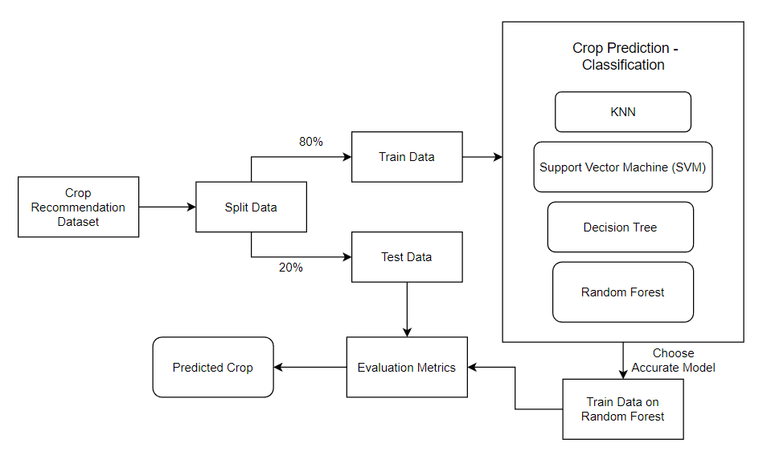
ALGORITHM FLOW DIAGRAM - CROP PREDICTION

Slide 8
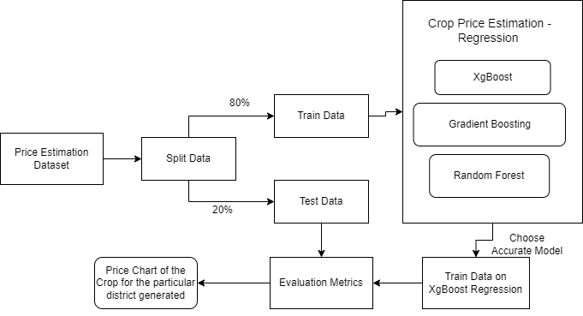
ALGORITHM FLOW DIAGRAM - PRICE ESTIMATION

Slide 9
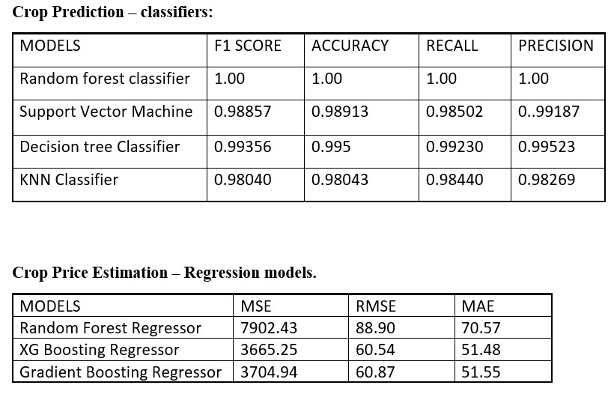
MODEL TRAINING RESULTS

Slide 10
MODEL TRAINING RESULTS

Slide 11
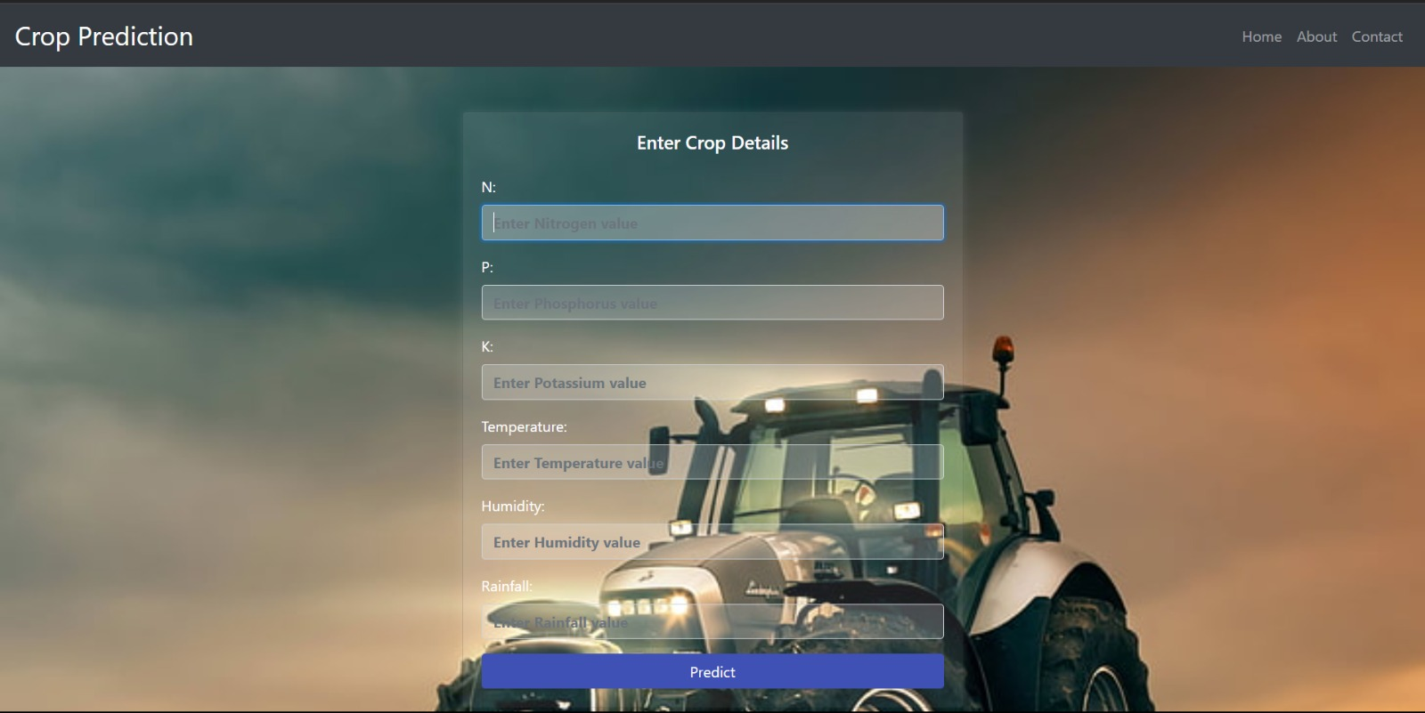
APPLICATION INTERFACE

Slide 12
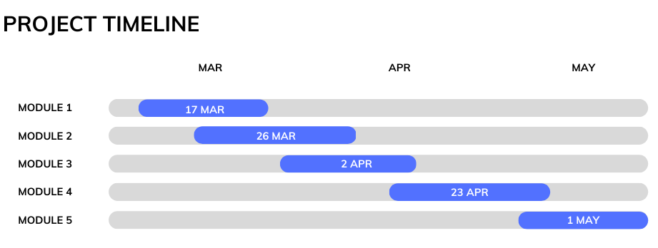

Slide 13
ATTRIBUTES
Crop Recommendation Dataset: Temperature, Humidity, Rainfall, N, P, K values, Crop label.
Price Prediction Dataset: District name, Crop name, Price Date, Final Price.

Slide 14


